Slide 1
Blacktown Chinese Christian Church
Welcome to Our English Service 16.02.2025
English Service 9:45 – 11:00 am
Worship Songs: Passage: Speaker: Topic: Response Song: Announcements and Closing Prayer Benediction
What A Beautiful Name Captain In Christ Alone Genesis 6:1-8 Matthew 24:2 Matthew 24:37-44 TBA TBA TBA

Slide 2
BCCC english service

Slide 3

Please keep all phones on silent

Slide 4
What A Beautiful Name
Ben Fielding, Brooke Ligertwood © 2016 Hillsong Music Publishing Australia CCLI Licence No. 5485849 . CCLI Song number: 7068424

Slide 5
Verse 1
You were the Word at the beginning
One with God the Lord Most High
Your hidden glory in creation
Now revealed in You our Christ

Slide 6
Chorus 1
What a beautiful Name it is
What a beautiful Name it is
The Name of Jesus Christ my King

Slide 7
Chorus 1
What a beautiful Name it is
Nothing compares to this
What a beautiful Name it is
The Name of Jesus

Slide 8
Verse 2
You didn't want heaven without us
So Jesus You brought heaven down
My sin was great Your love was greater
What could separate us now?

Slide 9
Chorus 2
What a wonderful Name it is
What a wonderful Name it is
The Name of Jesus Christ my King

Slide 10
Chorus 2
What a wonderful Name it is
Nothing compares to this
What a wonderful Name it is
The Name of Jesus

Slide 11
Chorus 2
What a wonderful Name it is
The Name of Jesus

Slide 12
Bridge
Death could not hold You
The veil tore before You
You silenced the boast of sin and grave

Slide 13
Bridge
The heavens are roaring
The praise of Your glory
For You are raised to life again

Slide 14
Bridge
You have no rival
You have no equal
Now and forever God You reign

Slide 15
Bridge
Yours is the Kingdom
Yours is the glory
Yours is the Name above all names

Slide 16
Chorus
What a powerful Name it is
What a powerful Name it is
The Name of Jesus Christ my King

Slide 17
Chorus
What a powerful Name it is
Nothing can stand against
What a powerful Name it is
The Name of Jesus

Slide 18
Bridge
You have no rival
You have no equal
Now and forever God You reign

Slide 19
Bridge
Yours is the Kingdom
Yours is the glory
Yours is the Name above all names

Slide 20
Chorus
What a powerful Name it is
What a powerful Name it is
The Name of Jesus Christ my King
What a powerful Name it is

Slide 21
Chorus
Nothing can stand against
What a powerful Name it is
The Name of Jesus

Slide 22
Outro
What a powerful Name it is
The Name of Jesus
What a powerful Name it is
The Name of Jesus

Slide 23
Captain
CCLI Licence No: 5485849

Slide 24
Verse 1
Through waters uncharted my soul will embark
I’ll follow Your voice straight into the dark
And if from the course You intend I depart
Speak to the sails of my wandering heart

Slide 25
Chorus
Like the wind You’ll guide
Clear the skies before me
And I’ll glide this o - pen sea
Like the stars Your Word

Slide 26
Chorus
Will align my voyage
And remind me where I’ve been
And where I am going

Slide 27
Verse 2
Lost in the shallows amidst fear and fog
Your truth is the compass that points me back north
Jesus, my Captain, my soul’s trusted Lord
All my allegiance is rightfully Yours

Slide 28
Chorus
Like the wind You’ll guide
Clear the skies before me
And I’ll glide this o - pen sea
Like the stars Your Word

Slide 29
Chorus
Will align my voyage
And remind me where I’ve been
And where I am going
Like the wind You’ll guide

Slide 30
Chorus
Clear the skies before me
And I’ll glide this o - pen sea
Like the stars Your Word
Will align my voyage

Slide 31
Chorus
And remind me where I’ve been
And where I am going

Slide 32
In Christ Alone
Keith Getty, Stuart Townend ©2001 Thankyou Music (Admin. by SHOUT! Music Publishing Australia) CCLI Licence No. 5485849. CCLI Song number: 3350395

Slide 33
Verse 1
In Christ alone my hope is found
He is my light, my strength, my song
This Cornerstone, this solid Ground
Firm through the fiercest drought and storm

Slide 34
Verse 1
What heights of love, what depths of peace
When fears are stilled, when strivings cease
My comforter, my All in All
Here in the love of Christ I stand

Slide 35
Verse 2
In Christ alone, who took on flesh
Fullness of God in helpless babe
This gift of love and righteousness
Scorned by the ones He came to save

Slide 36
Verse 2
'Til on that cross as Jesus died
The wrath of God was satisfied
For every sin on Him was laid
Here in the death of Christ I live, I live

Slide 37
Verse 3
There in the ground His body lay
Light of the world by darkness slain
Then bursting forth in glorious day
Up from the grave He rose again

Slide 38
Verse 3
And as He stands in victory
Sin’s curse has lost its grip on me
For I am His and He is mine
Bought with the precious blood of Christ

Slide 39
Verse 4
No guilt in life, no fear in death
This is the power of Christ in me
From life’s first cry to final breath
Jesus commands my destiny

Slide 40
Verse 4
No power of hell, no scheme of man
Can ever pluck me from His hand
Til He returns or calls me home
Here in the power of Christ I’ll stand

Slide 41
Outro
Till He returns or calls me home
Here in the power of Christ I’ll stand
Here in the power of Christ we stand

Slide 42

Bible reading

Slide 43
Genesis 6:1-8 (NIV)
When human beings began to increase in number on the earth and daughters were born to them, ² the sons of God saw that the daughters of humans were beautiful, and they married any of them they chose.

Slide 44
Genesis 6:1-8 (NIV)
³ Then the Lord said, “My Spirit will not contend with humans forever, for they are mortal; their days will be a hundred and twenty years.”
⁴ The Nephilim were on the earth in those days—and also afterward—when the sons of God went to the daughters of humans and had children by them. They were the heroes of old, men of renown.

Slide 45
Genesis 6:1-8 (NIV)
⁵ The Lord saw how great the wickedness of the human race had become on the earth, and that every inclination of the thoughts of the human heart was only evil all the time. ⁶ The Lord regretted that he had made human beings on the earth, and his heart was deeply troubled.

Slide 46
Genesis 6:1-8 (NIV)
⁷ So the Lord said, “I will wipe from the face of the earth the human race I have created—and with them the animals, the birds and the creatures that move along the ground—for I regret that I have made them.” ⁸ But Noah found favor in the eyes of the Lord.

Slide 47
Matthew 24:2 (NIV)
² “Do you see all these things?” he asked. “Truly I tell you, not one stone here will be left on another; every one will be thrown down.”

Slide 48
Matthew 24:37-44 (NIV)
³⁷ As it was in the days of Noah, so it will be at the coming of the Son of Man. ³⁸ For in the days before the flood, people were eating and drinking, marrying and giving in marriage, up to the day Noah entered the ark;

Slide 49
Matthew 24:37-44 (NIV)
³⁹ and they knew nothing about what would happen until the flood came and took them all away. That is how it will be at the coming of the Son of Man. ⁴⁰ Two men will be in the field; one will be taken and the other left.

Slide 50
Matthew 24:37-44 (NIV)
⁴¹ Two women will be grinding with a hand mill; one will be taken and the other left.
⁴² “Therefore keep watch, because you do not know on what day your Lord will come.

Slide 51
Matthew 24:37-44 (NIV)
⁴³ But understand this: If the owner of the house had known at what time of night the thief was coming, he would have kept watch and would not have let his house be broken into. ⁴⁴ So you also must be ready, because the Son of Man will come at an hour when you do not expect him.

Slide 52
Scripture quotations taken from The Holy Bible, New International Version® NIV®
Copyright © 1973, 1978, 1984, 2011 by Biblica, Inc.
Used with permission. All rights reserved worldwide.

Slide 53
Announcements

Slide 54





Account name: Blacktown Chinese Christian Church
Account number: 4216 50263
Offering
BSB: 112 - 879
Please put in "offering" as the reference
The offering box is available at the back of the hall

Slide 55
Prayer points

Slide 56
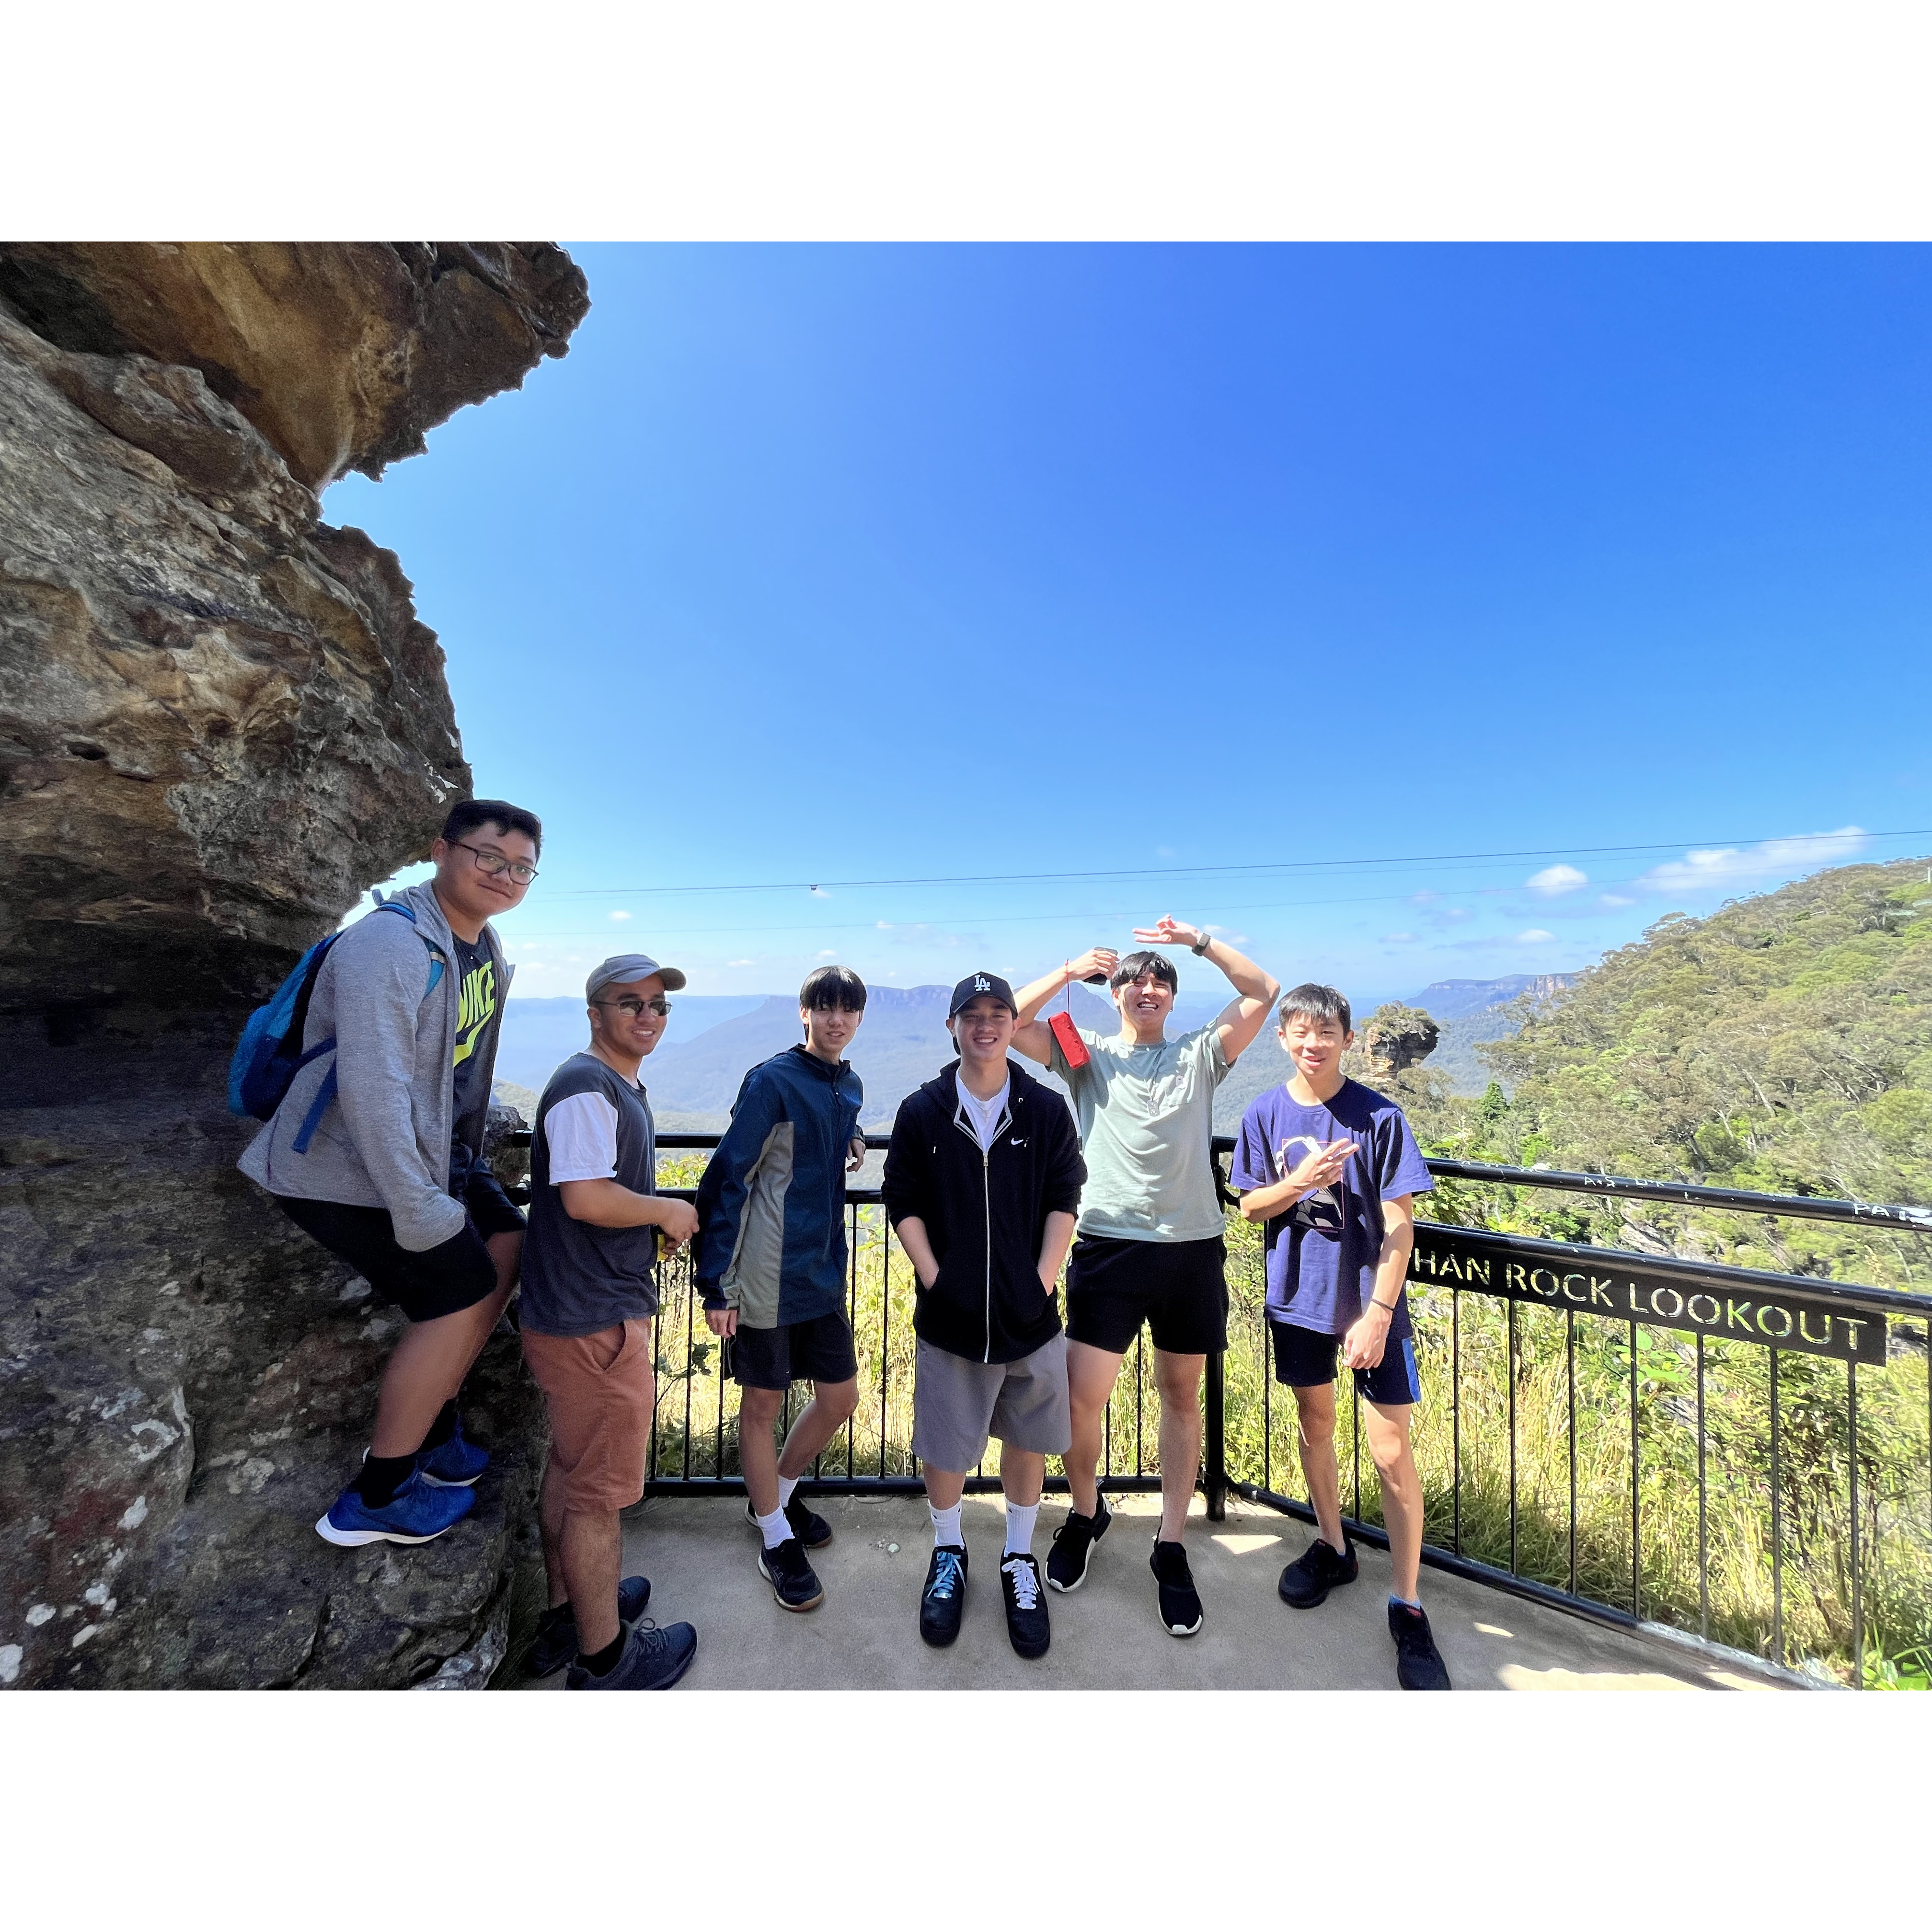
Mingle time!

